Slide 1
Feeding your bees
What, When and How to Feed

Slide 2
What and When to Feed
Early Spring (January – February in bee time)
The queen starts to lay again about mid to late January. This is a time when the bees are in need of protein to raise new bees. If the weather cooperates and there is a day in the mid to upper 50’s to 60’s this may be a good time to add a pollen patty.
Late February to Early March
This is a time when most colonies starve. The bees are trying to raise more and more bees and consuming lots of honey. If you in inspect your hives and the bees are at the top of the hive they may be running out of food. If this is the case you can purchase a product called Mega Bee Winter Patties or you could also make Candy Boards.
Mid to late March
Feed 1:1 Sugar Syrup w/HBH (Honey Bee Healthy) to help simulate the queen to lay usually around the time Maple trees bloom. Feed until there is a steady supply of nectar and pollen coming in.
Fall
Honey bees need 60 to 80 lbs. of honey to survive the winter. How much honey is that? 13 – 18 frames of honey for a medium configuration. 10 to 13 frames of honey in a deep configuration. Feed 2:1 Sugar Syrup (sugar : water) in late August to September to get the correct amount of honey. Pollen patties are also good to feed in the fall.

Slide 3
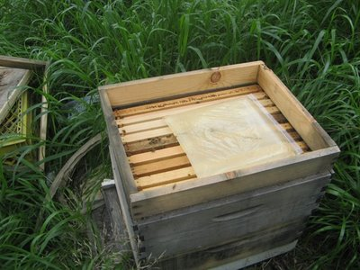
Feeder Types
Boardman
Hive Top
Division Board
Pail Feeder
Baggie Feeder

Slide 4
Bee Feeding Recipes
Spring Feeding Syrup
2 ½ quarts water
5 lbs. white granulated sugar
20 ml, Honey B Healthy (advised but not mandatory)
Bring water to a rolling boil then remove from the heat. Add sugar, mixing thoroughly. Do not allow this to remain on the heat as you will caramelize the sugar which will cause your bees to become ill. Stir in Honey B Healthy and allow mixture to cool before feeding to bees. If medications are to be added, wait until mixture cools and always follow the application directions for the medication. Once you begin feeding, do not stop until bees are able to forage for themselves naturally. This recipe will make one gallon of syrup.
Winter feeding Syrup
2 ½ quarts water
10 lbs. White granulated sugar
20 ml, Honey B Healthy (advised but not mandatory)
Use the same method as for the above feeding. This recipe will make one gallon of syrup.
Sugar Candy for Candy Board
7 lbs. of sugar
1 lb. of water (2 cups),
1 1/2 lbs. (about 1 1/8 cups) HFCS (or 2:1 sugar water)
1 lb. pollen substitute
Bring to a slow boil while stirring until candy consistency is reached about 220 to 230 degrees F. Take the candy off the heat and stir in a 1 lb. of pollen substitute with a whisk. Pour mixture into a mold and allow to cool.

